Slide 1
British Airways Customer Booking Analysis Task 2

Slide 2
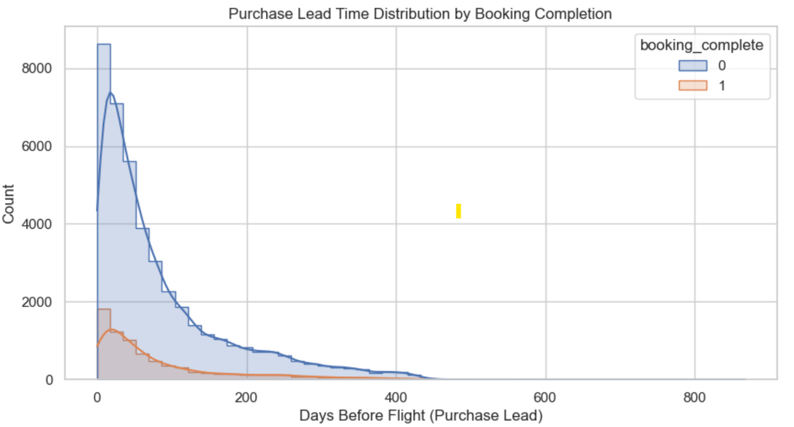
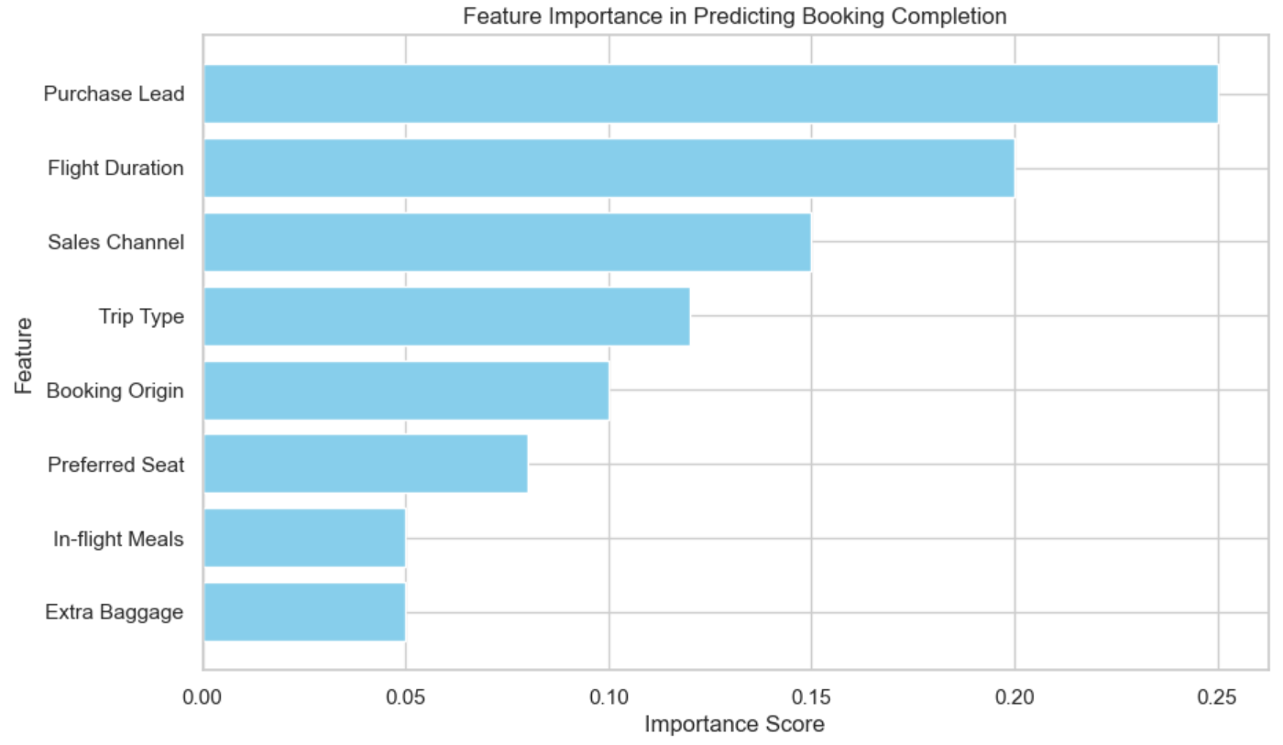
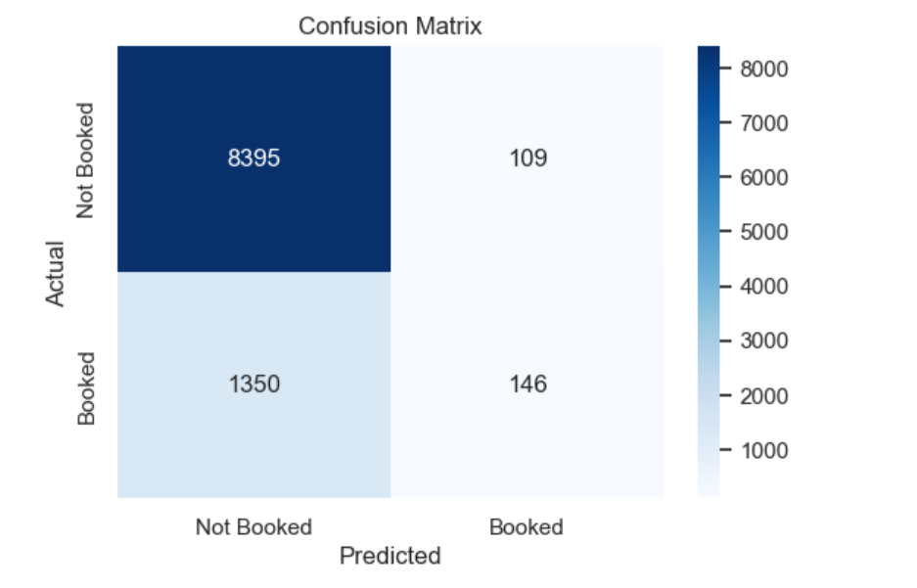
Predictive Modeling of Customer Bookings
Key Insights:
Data Overview:
50,000 entries, 14 columns, no missing values.
Booking Completion Rate: Only 15% completion
Key Influencing Factors:
Longer purchase lead times reduce booking completion rates.
Flight duration, sales channel, and extra services
(preferred seats, baggage) impact customer decisions.
Model Performance:
Random Forest Classifier achieved 85.4% accuracy.
Precision for completed bookings is low (57%),
indicating model struggles with true positive predictions.
Recommendations:
Improve model precision by refining feature engineering.
Focus marketing efforts on high-intent customers.
Optimize pricing strategies for bookings with longer lead times.

